Slide 1
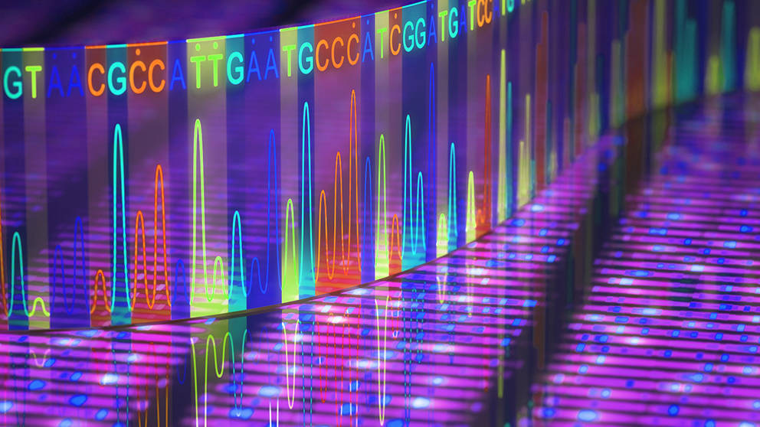
DNA Sequencing and Bioinformatics
Dominic G. Spinella, Ph.D.

Slide 2
Why Sequence DNA?
Best way to determine protein (amino acid) sequence.
Structure function relationships.
Understand the role of mutation and polymorphism in health and disease.
Forensic Applications.
Protein engineering.

Slide 3
What is necessary to sequence DNA?
Sufficient quantity of DNA of a single sequence (cloning; PCR).
A method for separating and resolving DNA fragments based on size (electrophoresis).
A method of detection of fragments (radioactive labels; fluorescent labels).
A means of discriminating between the 4 bases in a fragment of DNA.

Slide 4
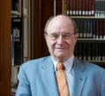
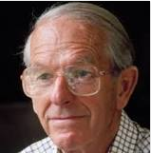
The Early Days
Two different methods were developed in the mid-1970s:
A chemical cleavage method developed at Harvard by Walter Gilbert and his graduate student, Allan Maxam, cleverly called Maxam-Gilbert or sometimes ‘chemical’ sequencing.
A DNA polymerase-based method developed by Fred Sanger at Cambridge equally cleverly called Sanger or “di-deoxy” sequencing.
Gilbert and Sanger shared the Nobel prize in 1980 for their work on DNA Sequencing*
*Fred Sanger had previously won a Nobel Prize in 1958 for elucidating the structure of insulin. He is one of only three people ever to have won two Nobel Prizes in the sciences.
Wally Gilbert
Fred Sanger

Slide 5
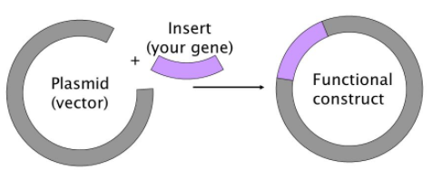
Maxam-Gilbert Sequencing
No longer in common use, but methodology is illustrative of the tools and techniques you are learning.
Clone the DNA fragment to be sequenced into a plasmid vector.
Transform E. coli
Purify plasmid DNA

Slide 6
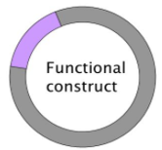
Maxam-Gilbert Sequencing
Linearize plasmid with restriction enzyme leaving 5’ overhang.
P-
P-

Slide 7
Maxam-Gilbert Sequencing
Remove 5’ phosphate with alkaline phosphatase

Slide 8
Maxam-Gilbert Sequencing
Label 5’ ends with ³²P using T4 kinase and ³²P γATP
P-
P-

Slide 9
Maxam-Gilbert Sequencing
Cut with a second restriction enzyme 3’ to the insert.
P-
P-

Slide 10
Maxam-Gilbert Sequencing
Purify 5’ ³²P-labeled insert by agarose gel electrophoresis.
You now have a double-stranded DNA fragment labelled at the 5’ end with ³²P
P
P-

Slide 11
Maxam-Gilbert Sequencing
M-G chemistry is a two-step process involving piperidine and two chemicals that selectively attack purines and pyrimidines.
Purines will react with dimethyl sulfate and pyrimidines will react with hydrazine in such a way as to break the glycoside bond between the ribose sugar and the base displacing the base.
Piperidine then cleaves the phosphodiester bond where the base has been displaced.
DMS and piperidine alone selectively cleaves at guanine nucleotides but dimethyl sulfate and piperidine in formic acid will cleave at both guanine and adenine.
Hydrazine and piperidine will cleave at both thymine and cytosine but in the presence of 1.5M NaCl will only cleave at cytosine.
Strands are separated by boiling and run on acrylamide gels in the presence of urea which keeps the strands separated.

Slide 12
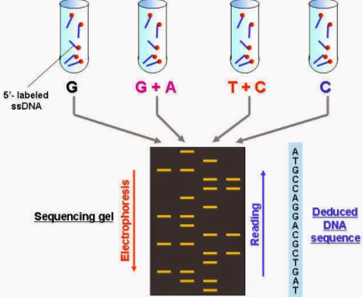
Maxam-Gilbert Sequencing
Set up each of the four reactions in separate tubes.
Run each reaction on a separate lane in a polyacrylamide sequencing gel.

Slide 13
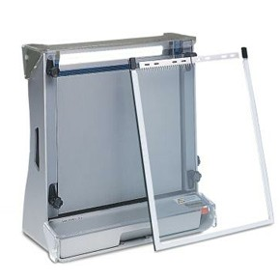
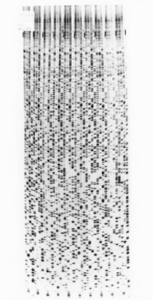
Maxam-Gilbert Sequencing

Slide 14
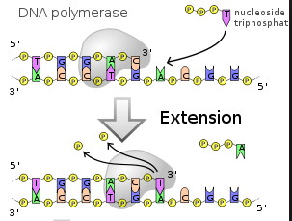
Sanger Sequencing
Makes use of the enzyme DNA Polymerase which will extend a short oligonucleotide sequence called a “primer” when it is hybridized (“annealed”) to a single-stranded “template” sequence in the presence of deoxynucleotide triphosphates (dNTPs).

Slide 15
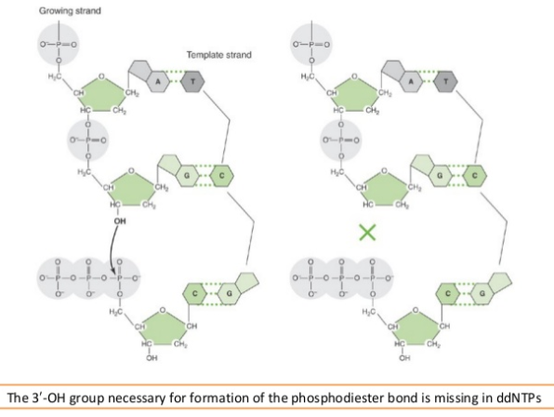
Sanger Sequencing
The clever “trick” to Sanger sequencing is the use of “dideoxy-nucleotide triphosphates” (ddNTPs) – which lack a 3’ OH group, mixed in with the dNTPs.

Slide 16
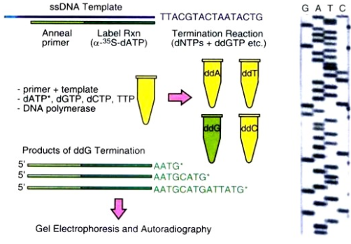
Sanger Sequencing

Slide 17
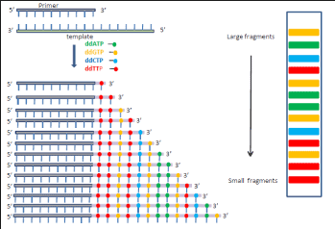
Sanger Sequencing
The next advance was to replace the radioactive tracer with fluorescent dyes that were coupled to the ddNTPs.
By using a different dye for each ddNTP, the reaction could now be run in a single tube instead of 4 different tube, and analyzed on a single lane of a gel instead of 4 lanes.

Slide 18
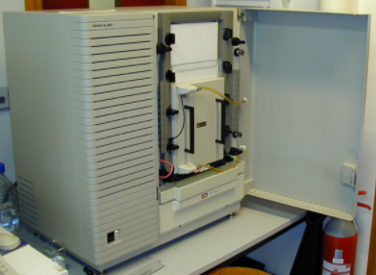
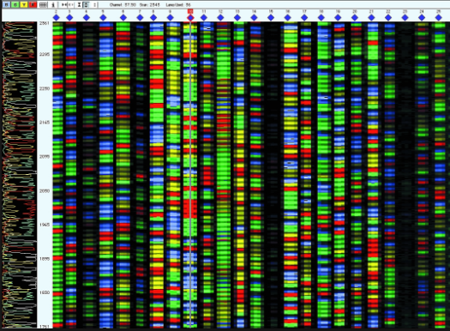
Sanger Sequencing
The use of fluorescently labeled ddNTPs led to the development of automated DNA sequencers.
These instruments worked by using a laser at fixed position near the bottom of the gel, and measuring and recording the wavelength of the fluorescent light as each “band” passed through that position, recreating a “virtual gel” on a computer with different colors corresponding to the different bases.

Slide 19
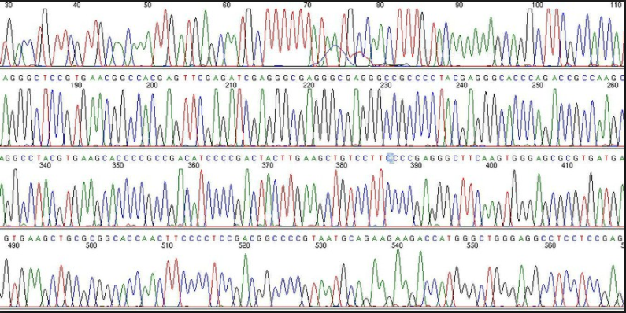
Sanger Sequencing
As each labeled DNA fragment passes in front of the laser it forms a peak of fluorescence intensity, a sort of “chromatogram” that is interpreted as sequence information. This chromatogram, is read by the computer (and can be read and confirmed by users) and is sometimes called an “electropherogram.” It remains the standard way that DNA sequence data are now reported.

Slide 20
Sanger Sequencing
How does one obtain the single-stranded DNA that is required as the template for DNA Polymerase I?
How does one know what oligonucleotide primer sequence to use if the gene sequence is unknown?

Slide 21
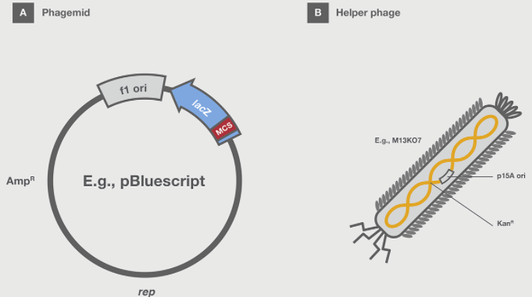
Sanger Sequencing
Many modern plasmids are “phagemids” which contain an origin of replication known as an f1 ori from a filamentous bacteriophage such as M13. These phage produce single-stranded DNA.
Phagemids can be transformed into competent E.coli as usual and are replicated as typical, double-stranded circular plasmids.
However, infection of a bacterial host containing a phagemid with a 'helper' phage, provides the necessary viral components to enable single-stranded DNA replication and packaging of the single-stranded DNA into phage particles which can be isolated from the bacterial culture.

Slide 22
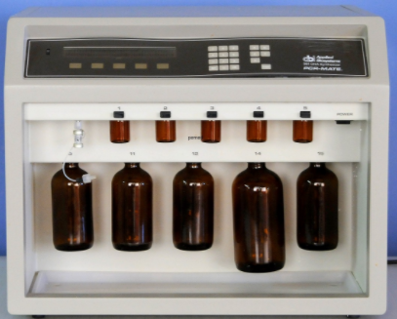
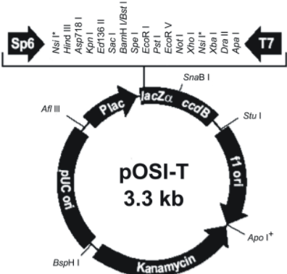
Sanger Sequencing
Oligonucleotide primers
Short 15-30 base single-stranded DNA primers are routinely chemically synthesized in vitro.
For cloned DNA from plasmids or phagemids, the priming site(s), such as SP6 or T7 is typically located in the vector immediately adjacent to the MCS.
Automated DNA synthesizer

Slide 23
Polymerase Chain Reaction (PCR)
The technique that changed everything
Simple but elegant technique developed in 1983 by Kary Mullis, then at the biotechnology company, Cetus in Emeryville, CA.
Allows in vitro amplification of any DNA sequence up to a few thousand base-pairs long without cloning.
Employs repeated primer extension reaction on DNA samples melted apart by heat.
Greatly facilitated by the later discovery of thermo-stable polymerases isolated from microorganisms that grow in hot springs.
Dr. Mullis won the Nobel prize in Chemistry in 1993 for his invention of PCR.
Kary Mullis

Slide 24
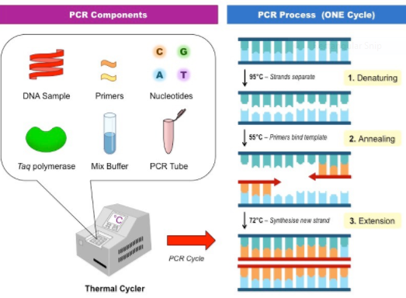
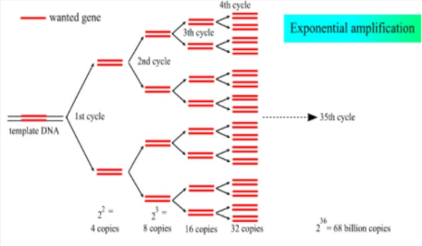
Polymerase Chain Reaction
PCR products can be sequenced directly, without any cloning, using the Sanger technique – using the same primers from which they were amplified.

Slide 25
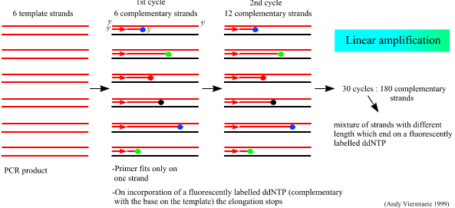
Sanger Sequencing Improvements
Cycle Sequencing:
Also known as linear PCR. Uses only ONE primer in the presence of double-stranded template (often a PCR product) in the presence of thermo-stable polymerase, dNTPs and fluorescent ddNTPs
As with PCR, extended primer is continuously melted at high temperature, cooled to reanneal to excess primer, and extended again.
Provides linear (not exponential) amplification, but increases signal.

Slide 26
Primer extension reactions
All of these techniques involve “primer extension” – the addition of dNTPs to the 3’ end of a single-stranded oligonucleotide called a “primer” following the sequence in a longer “template” stand of DNA by the action of a DNA polymerase.
5’-
Primer
3’-
Template
-5’
It is important to recognize that as long as the 3’ end of the primer base-pairs to the template, it does not matter if there are additional bases on the 5’ end of the primer that do NOT base-pair to the template.
5’-
Primer
3’-
Template
-5’

Slide 27
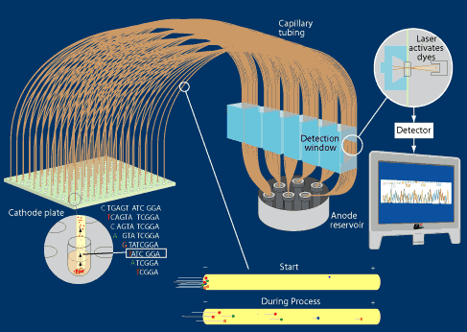
Sanger Sequencing Improvements
Capillary electrophoresis:
Uses long, thin gel filled tubes instead of a slab gel to perform the electrophoresis and resolve the fragments.
Provides better resolution and higher throughput (384 samples per run).

Slide 28
Shotgun Sequencing and the Human Genome
Using capillary sequencers and the Sanger method, all 3 billion bases of the human genome were finally sequenced in 2001 – a process that took 15 years and $3 billion.
The process utilized a technique called paired end “shotgun sequencing.’
In this technique, DNA is isolated from cells and randomly sheared into fragments by mechanical shearing (long DNA molecules are quite fragile).
The fragmented DNA is then size-selected and made blunt-ended using T4 DNA polymerase and DNTPs. This fills in any 5’ overhangs and chews back any 3’ overhangs.
The fragments are then cloned into a vector and individual clones are then sequenced by the Sanger method from both ends using vector-derived sequences as priming sites as usual.
Millions of “reads” are obtained and where overlaps occur, the sequences are aligned and extended by computer to form “contigs.”

Slide 29
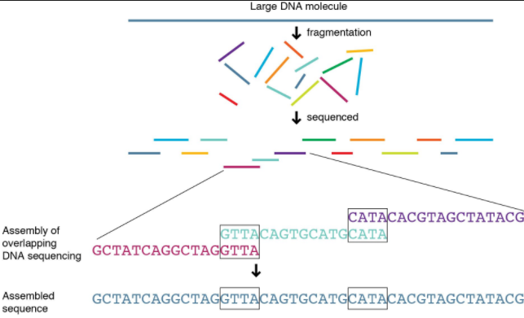
Shotgun Sequencing and the Human Genome

Slide 30
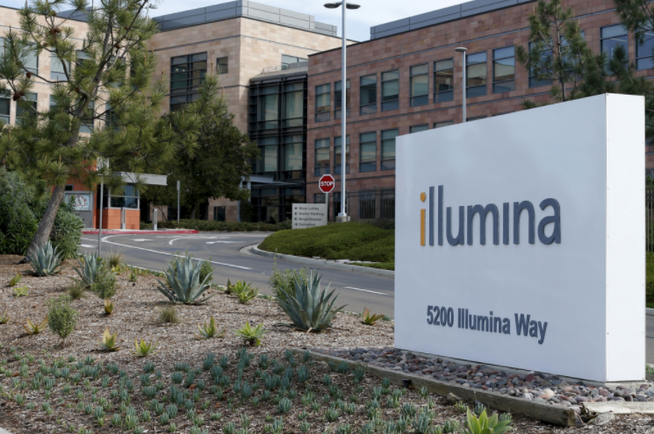
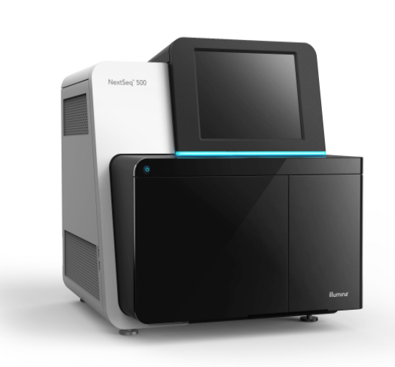
Next generation Sequencing (NGS)
Sanger sequencing at best produces read lengths of ~600 bp. With 384 capillary sequencers, that allows generation of ~200,000 bp per run.
“Next gen” DNA sequencers employ massively parallel sequencing techniques that allow reads of tens of millions (or more) bases per run at a fraction of the cost.
We will focus on the Illumina technology which has 80-90% of the market and has revolutionized DNA sequencing.

Slide 31
Illumina NGS
“Sequencing by synthesis”
The Illumina NGS platform essentially requires four steps:
Library preparation (sample preparation)
Solid phase amplification (“cluster generation”).
Sequencing by synthesis
Data Analysis

Slide 32
Illumina NGS
Library Preparation I
DNA to be interrogated is isolated and sheared into fragments (usually by sonication).
Can be genomic DNA, PCR amplified material, or cDNA reverse transcribed from RNA (“RNAseq”)
Fragments are made blunt by treating with T4 polymerase in preparation for adaptor ligation.

Slide 33
Illumina NGS
Library Preparation II
Specialized “adaptor” oligonucleotides are ligated to the ends and amplified by PCR to create two different adaptor sequences on the 5’ and 3’ ends of the molecule.
5’
3’
DNA Fragment
3’
5’
PCRAmplify
5’
DNA Fragment
3’
3’
5’
Fragments of 200-1000 bp are selected by gel electrophoresis.

Slide 34
Illumina NGS
Solid phase “bridge” amplification I
SS DNA is added to a “flow cell” which contains a “lawn” of millions of oligonucleotides complementary to the 3’ end and the 5’ end of the DNA fragments
5’
DNA Fragment
3’
The SS DNA is “captured” by a solid phase oligo complementary to the 3’ end which also serves as a primer for extension via DNA polymerase re-creating the double-stranded DNA (one strand of which is covalently bound to the flow cell.
5’
DNA Fragment
3’
3’

Slide 35
Illumina NGS
Solid phase “bridge” amplification II
The DNA is then melted apart and the originally captured stand is washed away leaving only the copy covalently bound to the solid phase
3’
DNA Fragment
The SS DNA bends and its 3’ end is captured by a nearby complementary oligo forming a “bridge.”
The process is repeated several times until many capture oligos are extended forming local clusters of identical SS sequences and their reverse complements.

Slide 36
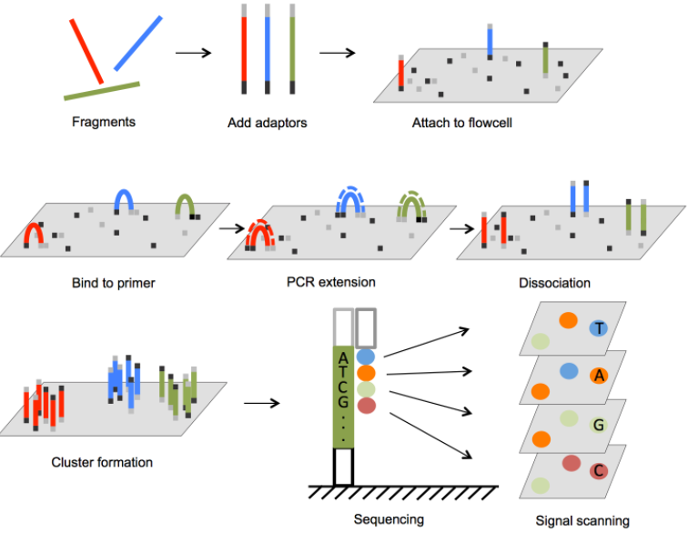
Illumina NGS :
Library formation and Amplification

Slide 37
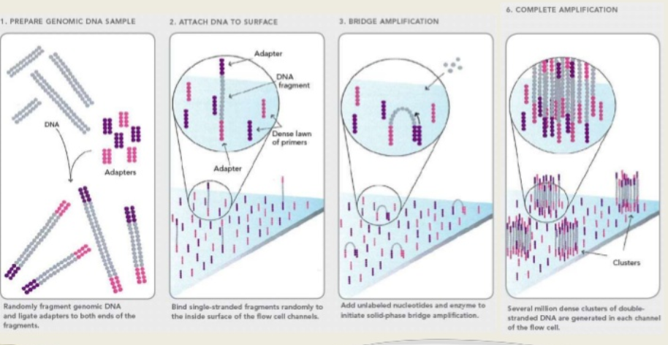
Illumina NGS :
Library formation and Amplification

Slide 38
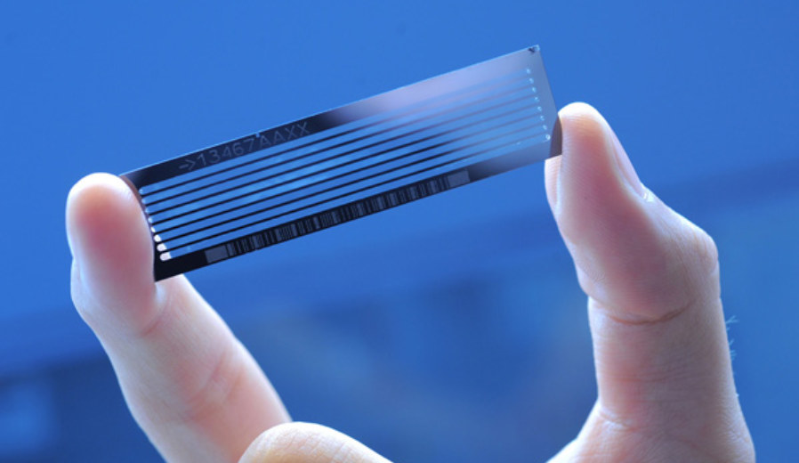
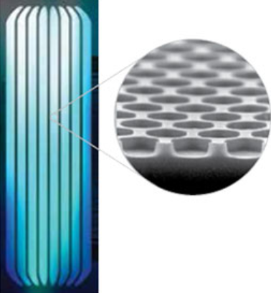
Illumina NGS :
Library formation and Amplification
All of these bridge amplification reactions take place in an automated fashion on a “flow cell.”

Slide 39
Illumina NGS :
Sequencing
Illumina sequencing chemistry is a single-standard primer extension reaction using florescent dNTPs.
The key innovation is the use of reversible terminators in which the fluorescent dye is cleaved and the ddNTP is converted into a dNTP in a single (proprietary) reaction.
Each cycle extends the primer by one base and causes a cluster to fluoresce in a single color depending on whether an A, G, T or C has been added.
The reaction is then “reversed” and the next cycle is performed.
Each cycle determines the sequence of one base.

Slide 40
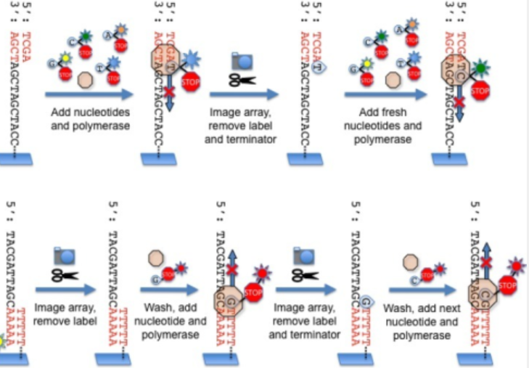
Illumina NGS :
Sequencing

Slide 41
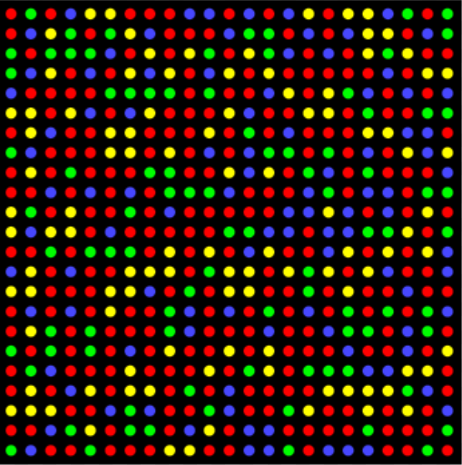
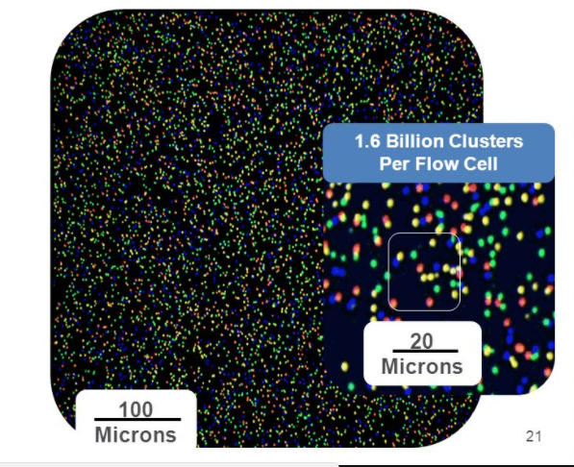
Illumina NGS :
Sequencing
The changes in color of each cluster after each cycle allows read out of the sequence. Depending on the particular instrument model, there can be over 1.5 billion clusters in a single flow cell.

Slide 42
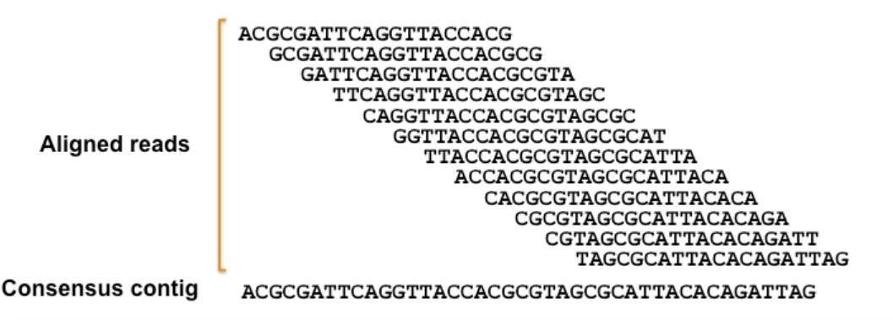
Illumina NGS :
Data Analysis
Each cluster generates a “read” from extension of a primer that hybridizes to a sequence contained in the adaptor; Forward and reverse reads are obtained.
Read lengths depend on the number of cycles (1 base per cycle). 50 – 100 base reads are typical.
Because original DNA was fragmented randomly, individual “reads” often overlap. The overlapping reads are assembled by the software into “contigs.”
The number of reads that contain any given position is called the “coverage” and the required average degree of coverage depends on the use. 30X average coverage is considered a minimum.

Slide 43
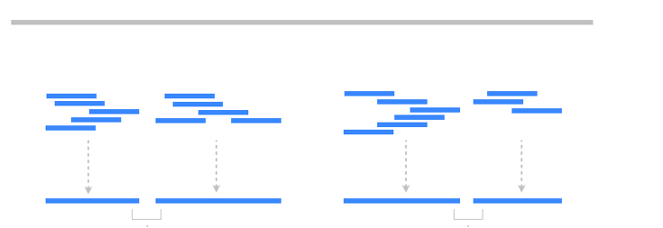
Illumina NGS :
Data Analysis
Because the human (and many other) genome has already been sequenced, contigs can often aligned to a reference genome. This is sometimes referred to as “re-sequencing.”
Often done to assess mutation and polymorphism.
Reference genome
reads
reads
contigs

Slide 44
Illumina NGS :
Data Analysis
DNA “barcodes” can be added to the primers.
Typically random 6 base sequences (4096 different possible sequences)
Allows running of different samples (e.g. different patients, different experiments) in a single run.
Software deconvolutes data and only generates contigs from sequences with the same barcode.
5’
DNA Fragment
3’
3’
5’

Slide 45
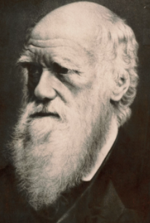
Bioinformatics:
Sequence Alignments
Provides a measure of degree of relatedness between nucleotide or protein sequences.
Allows one to draw biological inferences regarding:
Structural relationships
Functional relationships
Evolutionary relationships
Charles Darwin

Slide 46
Sequence Alignments
Some Terminology
Similarity
Quantitative attribute usually expressed as a percent identity between two sequences.
Quantifies changes that occurred as two sequences diverged (i.e. substitutions, insertions, deletions).
Conservation of residues over evolutionary time identifies residues crucial for maintaining structure or function of a protein.
High degrees of sequence similarity may imply common evolutionary history (common ancestor).
Possible commonality in biological function.

Slide 47
Sequence Alignments
Homology
Implies evolutionary relationship and common ancestry
Not a quantitative attribute – genes either are or are not homologous.
Orthologs
Two sequences that are direct descendants of a common ancestral sequence.
Likely to have a similar domain and three dimensional structure
Usually retain same biologic function over evolutionary time and can be used to predict gene function of a newly sequenced gene or protein.
Paralogs
Genes that arose by duplication of a single gene within a particular lineage
Can take on new functions over evolutionary time; hence less likely to perform similar functions.

Slide 48
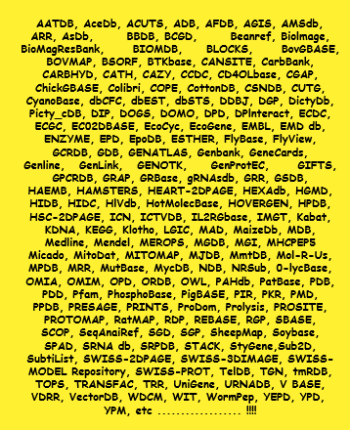
Databases
Sequence alignment always involves a comparison between two sequence.
Either YOU provide both sequences and assess the degree of similarity or
more commonly, you search a database of sequences, making pair-wise comparisons one at a time.
There are MANY databases out there!
E.g. Genbank
Maintained by the NCBI (part of the NLM)
Contains over 200 million sequences and over 235 billion bases of DNA

Slide 49
Search Algorithms
Obviously, it is difficult enough just to align two large sequences by eye; manually searching a database of millions of sequences is impossible.
You need a computer – and that means you need a set of instructions to that computer.
That set of instructions is called an algorithm.
There are many search algorithms in use today. We will learn about one of the most powerful, called BLAST.
Basic Local Alignment Search Tool

Slide 50
The BLAST family of programs
All BLAST programs search a user-input sequence (either DNA or protein) called a “query” against either another sequence (called a “target”) or against a database of target sequences.
blastn Given a DNA query, returns the most similar DNA sequences from a user-specified DNA database.
blastp Given a protein query, returns the most similar protein sequence from a user-specified protein database.
blastx Given a nucleotide query, compares the conceptual translation in all 6 reading frames (forward and revers) and returns the most similar protein sequence from a user-specified protein database.
tblastx Given a nucleotide query, compares the conceptual translation in all 6 reading frames (forward and revers) to the 6-frame translations of a nucleotide database. Because the code is degenerate, tblastx is better for finding distant relationships between sequences
tblastn Compares a protein query to the 6-frame translations of a nucleotide database.

Slide 51
The BLAST algorithm
Remove low complexity regions
Many nucleotide (and some protein) sequences have stretches of repeated elements – a long stretch of A’s for example in a nucleotide sequence. These are called “low complexity regions” and the first thing BLAST does is remove these from the query sequence
Create list of “words” of length k and look for exact matches in the target sequence, or database of target sequences. Consider the following protein sequence:
WYRQGS
If k is set to 3, the “words” are
WYR
YRQ
RQG
QGS
The BLAST algorithm searches each of these “words” for a match in the target or database. The default word length, k, is 3 for protein searches and 11 for nucleotide searches.

Slide 52
The BLAST algorithm
Remove low complexity regions
Many nucleotide (and some protein) sequences have stretches of repeated elements – a long stretch of A’s for example in a nucleotide sequence. These are called “low complexity regions” and the first thing BLAST does is remove these from the query sequence
Create list of “words” of length k and look for exact matches in the target sequence, or database of target sequences. Consider the following protein sequence:
WYRQGS
If k is set to 3, the “words” are
WYR
YRQ
RQG
QGS
The BLAST algorithm searches each of these “words” for a match in the target or database. The default word length, k, is 3 for protein searches and 11 for nucleotide searches.

Slide 53
The BLAST algorithm
Extend the words.
Once a match is found between a word and a target sequence, the program tries to extend the match on either side.
The extensions are given a “score” depending on the fidelity of the match.
Remember – not all matches are perfect matches. The BLAST programs therefore employ a “substitution matrix” to generate these scores.
For nucleotide queries, the matrix is very simple: A perfect match is given a score of +1 while any mismatch is scored as -3. As long as extending the alignment in either direction keeps increasing the score, extension continues.
These “extensions” are called high-scoring segment pairs, or ‘HSPs.’ The algorithm continues extending the ‘match’ until the ‘score’ begins to decrease.

Slide 54
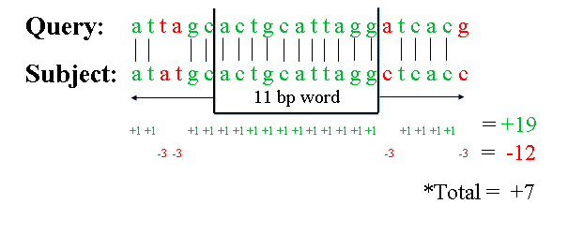
The BLAST algorithm
Example of blastn scoring system

Slide 55
Protein substitution matrices
Nucleotide substitution matrices are easy. As long as all four nucleotides are found in equal abundance (approximately true), all mismatches are scored the same (-3).
Amino acid mismatches, however, are trickier. Scoring matrices must take into account side chain, size, chemistry and function.
Conservation: What amino acids can substitute for another without dramatically affecting structure and function?
Ile/Val – both small and hydrophobic
Ser/Thr – both polar
Arg/Lys – both pos. charged
Cys – involved in formation of disulfide bridges
Trp – very bulky side chain
Frequency: Not all amino acids occur at the same frequency in proteins (e.g. Trp is relatively rare, Ser is relatively common in most proteins).
All these must be taken into account when determining how much to “award” a perfect match, or “penalize” a mismatch.

Slide 56
Protein substitution matrices
There is no perfect answer to the question of how to score matched and mismatched amino acids in an alignment.
Blast employs a user-definable series of substitution matrices. The higher the number, the more similar aa’s are selected for (and dissimilar aa’s selected against). Lowering the matrix will find more distant relationships. The default is a matrix called BLOSUM62

Slide 57
Protein substitution matrices
Nucleotide substitution matrices are easy. As long as all four nucleotides are found in equal abundance (approximately true), all mismatches are scored the same (-3).
Amino acid mismatches, however, are trickier. Scoring matrices must take into account side chain, size, chemistry and function.
Conservation: What amino acids can substitute for another without dramatically affecting structure and function?
Ile/Val – both small and hydrophobicSer/Thr – both polar
Arg/Lys – both pos. charged
Cys – involved in formation of disulfide bridges
Trp – very bulky side chain
Frequency: Not all amino acids occur at the same frequency in proteins (e.g. Trp is relatively rare, Ser is relatively common in most proteins).
All these must be taken into account when determining how much to “award” a perfect match, or “penalize” a mismatch.

Slide 58
The BLAST algorithm
What about gaps?
In the evolution of nucleotide and protein sequences, amino acids or nucleotides can be lost or extra ones gained. These are called insertion/deletions, or “indels.”
Sometimes two sequences can generate a higher “score” (and two adjacent HSPs can be joined) by the insertion of gaps into either the query or target sequence.
Nevertheless, aligning two sequences by inserting lots of gaps into one or the other can be counterproductive.
The scoring algorithm deals with this by penalizing both the opening of a gap and the extension of a gap.
For blastn the gap penalty is -5 to open a gap and -2 for each base it is extended.
For blastp the gap penalty is -11 to open a gap and -1 for each amino acid it is extended.

Slide 59
The BLAST algorithm
Statistics
BLAST returns to the use a list of “hits” (HSPs) in the database that exceed a program-defined threshold of statistical significance.
Significance depends not only on the size and fidelity of the “match” but also on the size of the database.
Consider the following nucleotide sequence: AGGTCGAC.
Since this sequence has 8 nucleotides, the probability of finding a perfect match in another random sequence of 8 bases is one in 4⁸ = 65,536. However, in a database of 230 billion bases, you would expect over 3.5 million matches just by random chance!
The actual formula used by BLAST to estimate probabilities and the “significance” of matches returned are based on a statistical model called the Gumbel extreme value distribution – and is beyond the scope of this class.

Slide 60
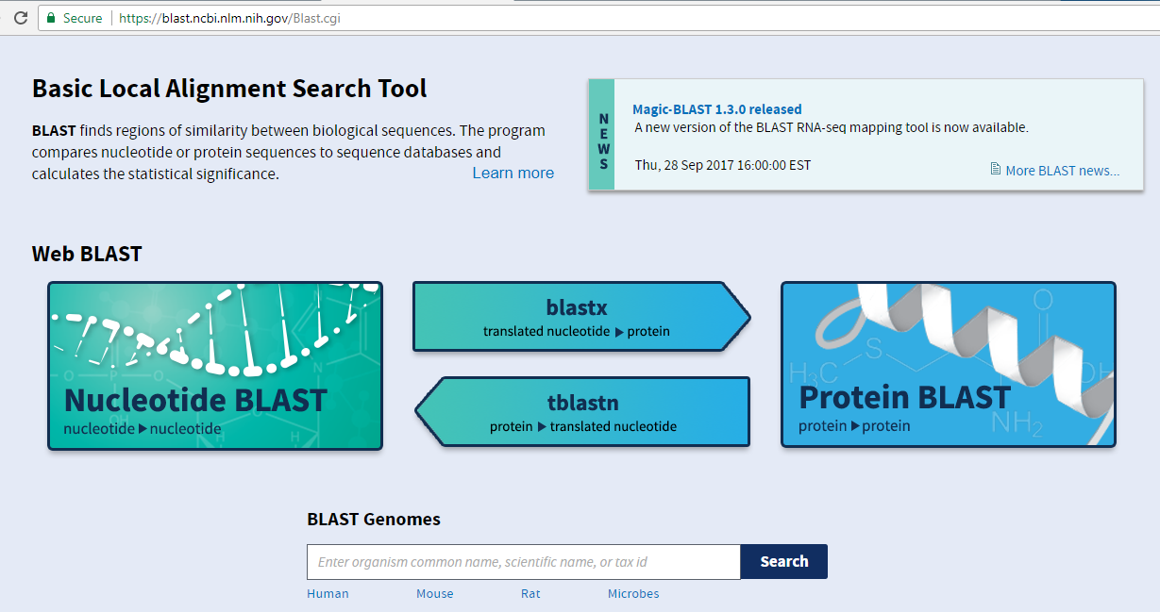
Running BLAST
Blast.ncbi.nlm.nih.gov/Blast.cgi

